Slide 1
Lesson 1 - Intro

Slide 2




Who we are?
Bohdan
Vlad
Volodymyr

Slide 3
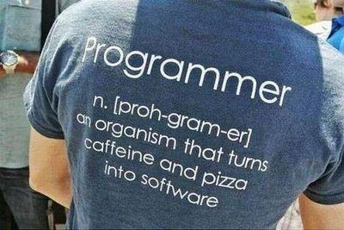
Lesson goals
Greetings
Expectations
Existing Knowledge
Last Year experience
Course Goals
Course Rules
Homework

Slide 4
Greetings Expectations Knowledge
Your first name
Short info about yourself (education, work, hobbies, etc)
Your previous experience at GeekHub
Your expectations from course
How prepared to course (completed courses, books about Java etc)
Current knowledge of Java or any other language

Slide 5
Last years experience
5 years on GeekHub J4W course
Last year 15 students
Last year 4 students got GeekHub certificate
Many of students got a job as a Junior Java developers in different companies in Cherkasy
P.S. Asking questions is a good way to learn more

Slide 6
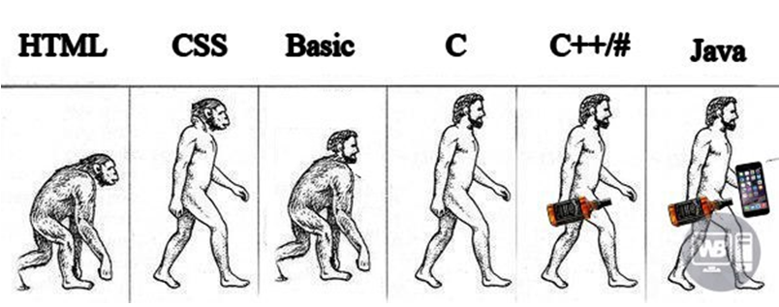
Course goals
Read
Understand
Create
Update

Slide 7


Course action plan
Core
Basics, OOP
Exceptions
Code testing
Collections, Generics
Functional Programming
IO
Concurrency
Database
Web
Servlet API
REST
Spring Framework
MVC
Boot
JDBC
Security
Microservices
…

Slide 8
Course activities
Lectures
Practices
Homeworks
Course work

Slide 9
Homework type ?
Every homework task will be dedicated only to specific topic and code will not be related on previous homeworks
Every homework task related to each other and as a final result we will get an fully functional project

Slide 10
IDE
IntelliJ IDEA by JetBrains

Slide 11

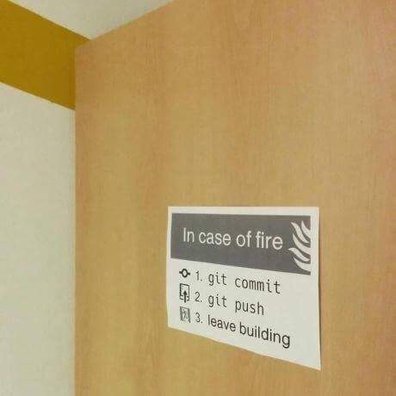
Version Control System (VCS)

Slide 12

Cloud repository

Slide 13
Homework Quality Control
GitHub issues
Code Review
Fixes after Code Review
Homework Common Issues Review

Slide 14

Homework Quality Rules
Code is formatted
Code is organized
Code is verified
.editorconfig
CheckStyle

Slide 15
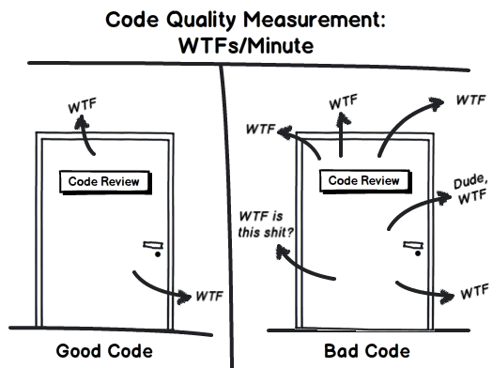
Homework Quality Rules

Slide 16
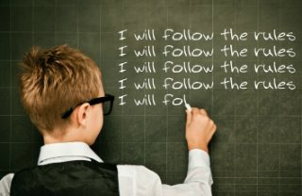
Code convention: Read. Remember. Follow.
Java Code Convention by Google

Slide 17
Homework Quality Rules
Commit message pattren: L## descriptable message
Example:
L01 Implement bubble sort
L12 Fix code formatting
Issue title pattern: L## Homework Review
Example:
L01 Homework Review
L12 Homework Review

Slide 18
Good coding practices
Best practice - is a technique or methodology that, through experience and research, has proven to reliably lead to a desired result.

Slide 19
Good coding practices

Slide 20
Good coding practices
Java Code Convention: by Google, by Oracle
Clean code principles
40 Tips that will change your coding skills forever
Developers jargon
Books:
“Clean Code” and other by Robert Martin
“Java: The Complete Reference” by Herbert Schildt

Slide 21
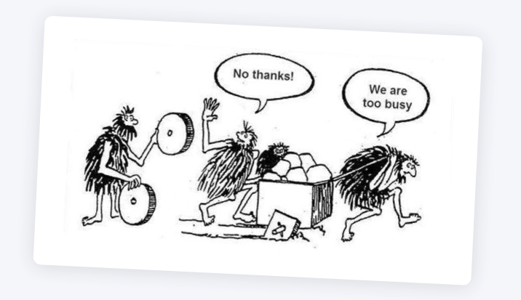
In any unclear situation – think

Slide 22

Setup required software
Join Java for Web Slack channel
Create GitHub account
Configure checkstyle and editorconfig for IDEA
Complete .gitignore configuration
Implement and push a Hello World greeting program
Create a GitHub issue with successful program execution and checkstyle config screenshots. Assign it to lector

Slide 23
Quality is more important than amount

Slide 24
Thanks!
Questions?
Find us in Slack:
@Bohdan Cherniak
@Vlad Nikolenko
@Volodymyr Vedula

